Slide 1
Android-Matlab Image Processing

Slide 2
Objectives:
Take a picture of chemical glass from Android phone, send picture to Matlab, perform image processing in Matlab to read intensities of chemical glass object, and send the values of intensities back to Android.

Slide 3
Android-Matlab Communication
Android to Matlab and Matlab to Android communication will be established using TCP/IP technique. Facts:
TCP/IP guarantee the data being sent; never get data lost. Comparing to UDP connection, the TCP/IP connection has a built-in algorithm to check the data consistency between server-client
TCP/IP is easy to implement in both Matlab and Android
TCP/IP can handle large data streaming
Transmission rate is high

Slide 4
There are 2 programs:
Intensity, is an Android program to take a picture of chemical glass, send this picture to Matlab, receive the intensity values from Matlab and display to the user.
Main image processing program, is a Matlab program to receive image data from Android, performs image processing algorithm to read the intensity values of chemical glass, and send the intensity values back to Android

Slide 5
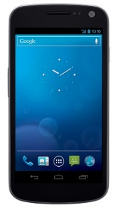
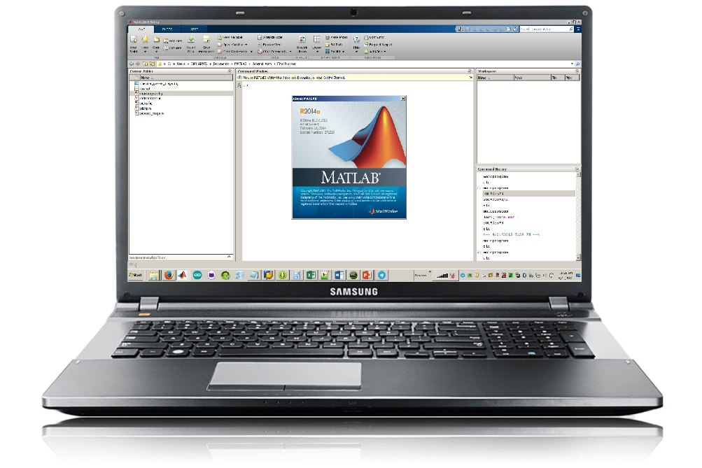
Android-Matlab Connection via TCP/IP
Take picture
Receive picture
Send picture data
Send intensity values
Display intensity value
Perform read intensity values
INTENSITY PROGRAM
IMAGE PROCESSING PROGRAM

Slide 6
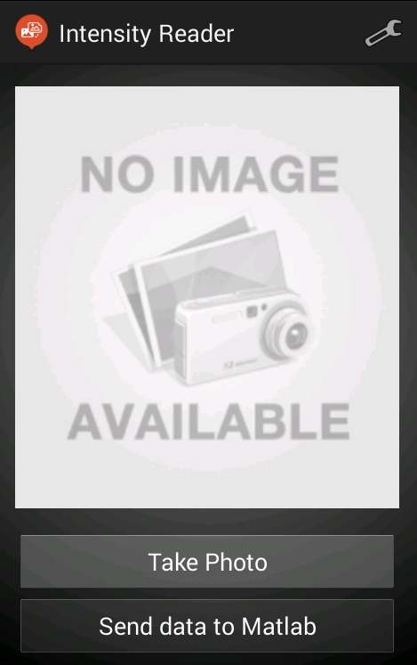
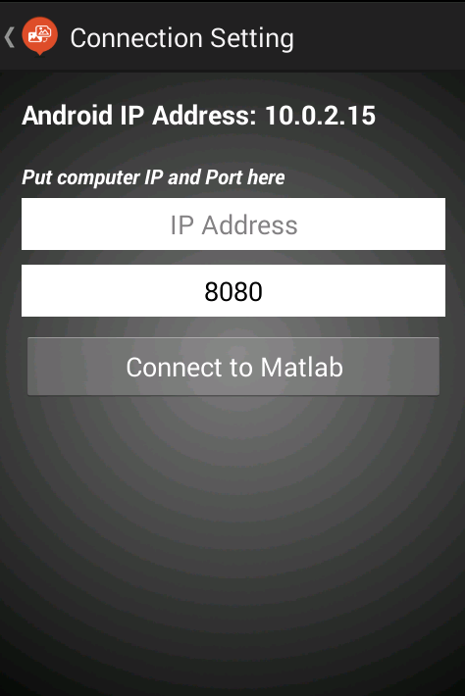
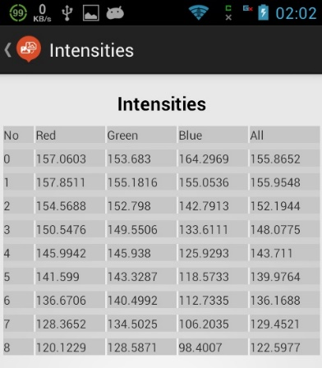
Intensity (Android Program)
Open Connection Setting Page
Send picture to Matlab, and receive intensity of detected chemical glass. When done receiving, open List Page

Slide 7
Intensity (Android Program)
Input: a picture of chemical glass taken from device camera, from within Intensity program
Output: list of intensity values of chemical glass
Important activities: establish TCP connection to Matlab, picture capture, resize picture, send picture via TCP connection to Matlab, receive values from Matlab via TCP connection

Slide 8
Intensity (Android Program)
Program Steps:
Setup TCP client and connect to already-open TCP server on Matlab
Take a picture
Resize picture
Send all pixels values of the picture to Matlab
Receive intensity value from Matlab

Slide 9
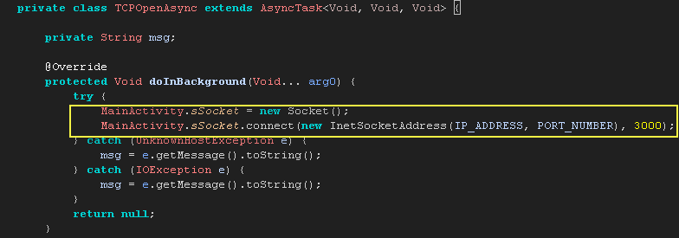
Intensity (Android Program) Connect to TCP server
On Android, TCP connection setup as a client must be run on background thread. Here we use class AsyncTask. Parameter to be pass are ip address of the server, port number and time limit to make the connection.

Slide 10
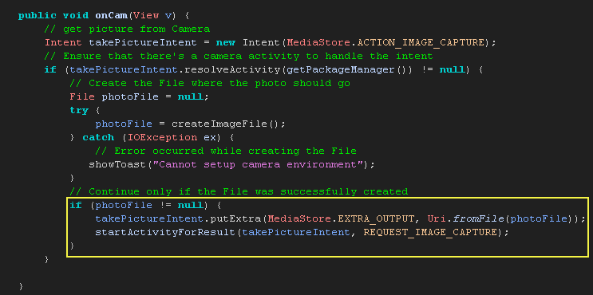
Intensity (Android Program) Take a picture using standard Android Intent
Picture can be taken using Android intent for photo capture. This will bring to standard Android Activity for taking picture.

Slide 11
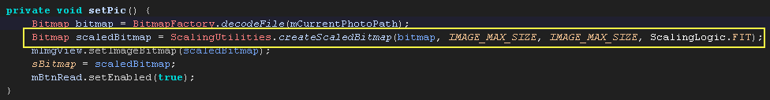
Intensity (Android Program) Resize Picture
Because bitmap format on Android is different from Matlab’s, then we must send the pixel values of image instead the image object. To avoid sending very large pixel data, the program will resize the picture to maximum width/height of 400 pixels (maintain the aspect ratio).
Hence, the maximum number of pixels to be sent are 400 x 400 x 3, where 3 is the color channel (red, green and blue)
where IMAGE_MAX_SIZE = 400

Slide 12
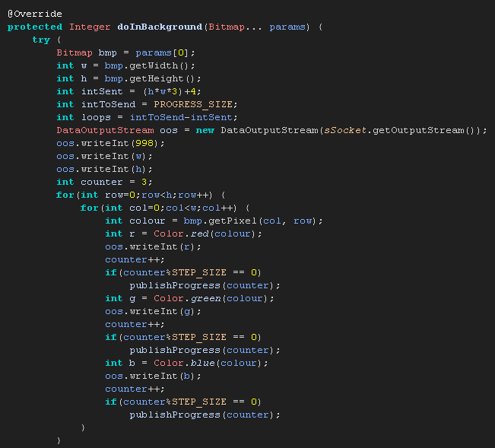
Intensity (Android Program) Send Picture (in pixel value) to Matlab via TCP
The pixels value of a picture will be sent to Matlab. To avoid blocking the main Android UI in program, we must send it inside a background thread AsyncTask.

Slide 13
Intensity (Android Program) Receiving Intensity values
Once all pixels value have been sent, the program will wait for the response from Matlab. We create another background thread AsyncTask to perform this operation (see the codes on next page).

Slide 14
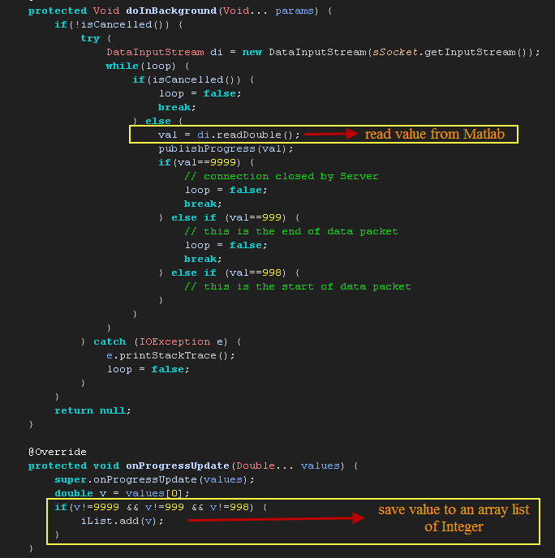

Slide 15

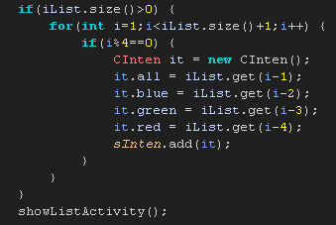
Intensity (Android Program) Receiving Intensity values
After all the intensity values have been received, the program will display it on another Android Activity

Slide 16
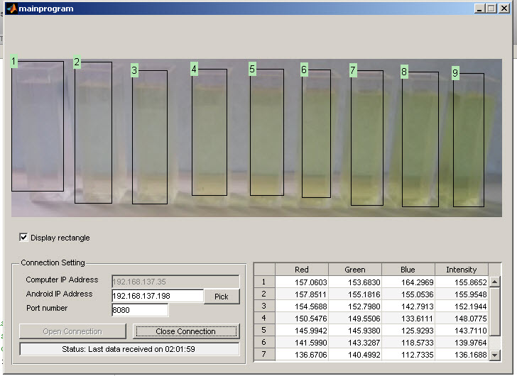
Image Processing (Matlab Program)

Slide 17
Image Processing (Matlab Program)
Input: Pixel value data for each color channel of a picture taken and sent from Android
Output: Intensity values of chemical glass detected on the picture, send back to Android

Slide 18
Image Processing (Matlab Program)
Program Steps:
Setup and Open TCP Server connection channel
Receiving pixel data from Android through TCP
Process Image to detect chemical glass and calculate the intensity value of each chemical glass detected
Send the intensity value back to Android

Slide 19

Image Processing (Matlab Program) Open TCP Connection as a Server
To setup TCP connection on Matlab, we have to explicitly define Matlab as a TCP server using available IP Address from Android and the port number
ipStr = IP Address of Android
port = Port Number

Slide 20
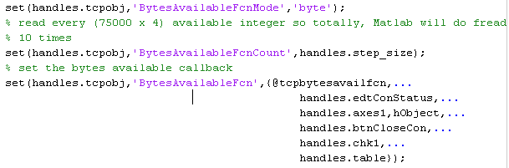
Image Processing (Matlab Program) Define callback
Define callback for receiving data through TCP channel. It is a function which will be executed when amount of data has been received. The amount of data for triggering this function has also need to be defined

Slide 21
Image Processing (Matlab Program) Receiving Pixel Values from Android
Android sends the value of all pixels available in the picture taken, for all 3 color channels (red, green and blue). When all data has been received, the Matlab program will trigger TCP Callback function. Inside this function, Matlab program will do Image Processing algorithm to detect chemical glass and calculate the intensity of it (see code on the next page).

Slide 22
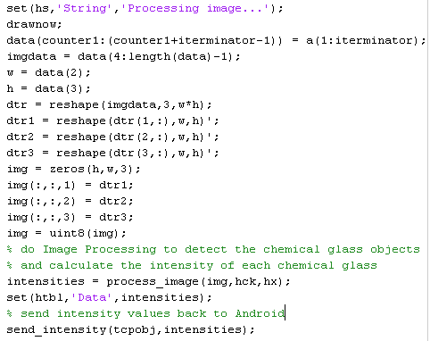
Image Processing (Matlab Program) Receiving Pixel Values from Android

Slide 23
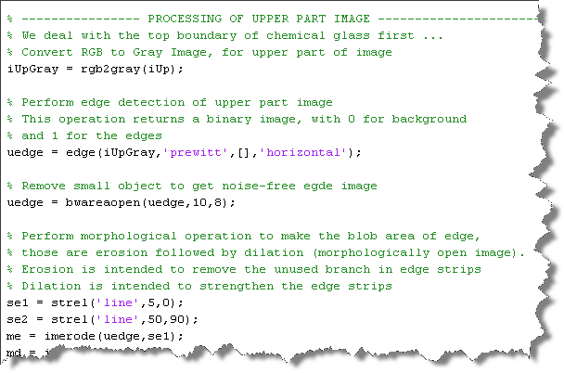
Image Processing (Matlab Program) Calculate Intensity of Chemical Glass Object
This code has the same algorithm with the previous version of Image Processing (see attached m-file process_image.m)

Slide 24
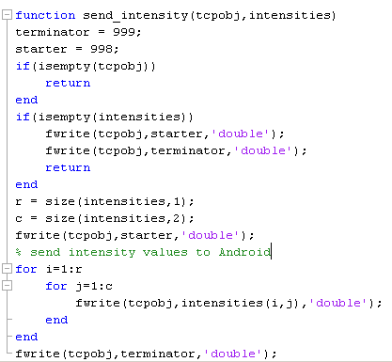
Image Processing (Matlab Program) Send intensity value to Android
The intensity value is sent using fwrite syntax

Slide 25
Sample result
Matlab Program Result
Android Program Result

Slide 26
Thank You

